Slide 1



Slide 2


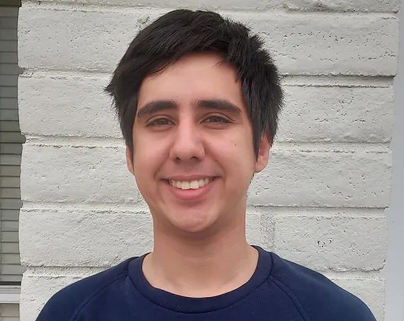
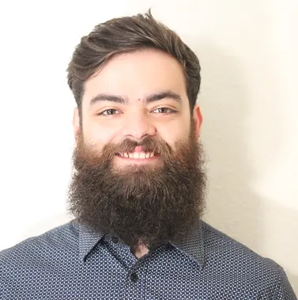

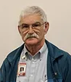
SPECIAL THANKS TO
Luis Arce Gutierrez
Nicholas Stein
Dr. Tim Frank
Rick Sparber

Slide 3
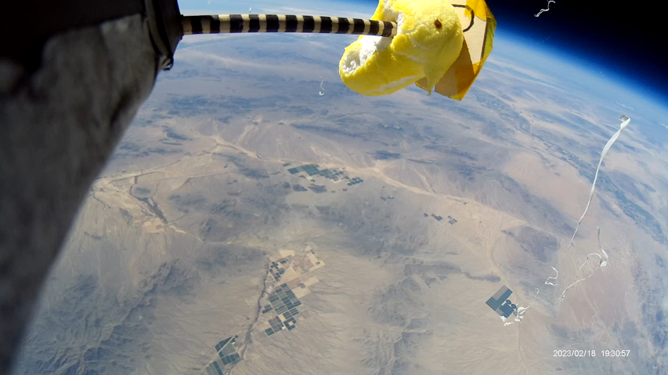
PROJECT OBJECTIVES
Demonstrate the RF skip in the atmosphere.
Gather and record CO2 and humidity readings from the atmosphere.
Examine the effects of radiation on Garden Cress Seeds.
Record the expansion of a marshmallow Peep in high altitude.

Slide 4
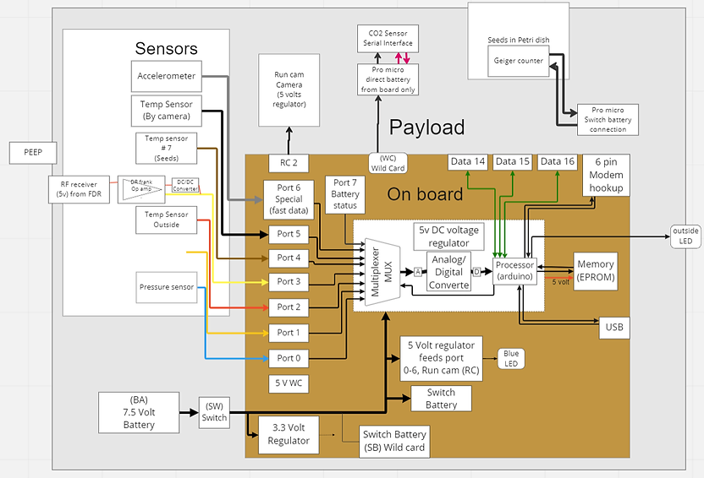
System Block diagram

Slide 5
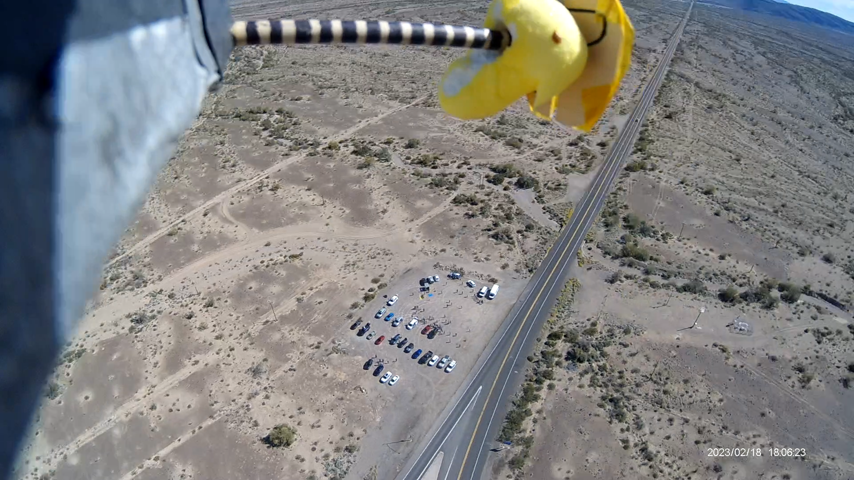
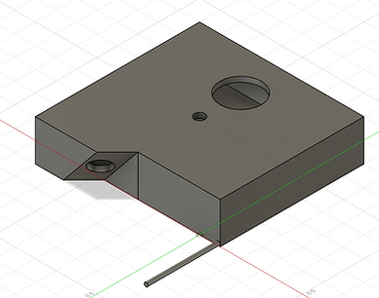
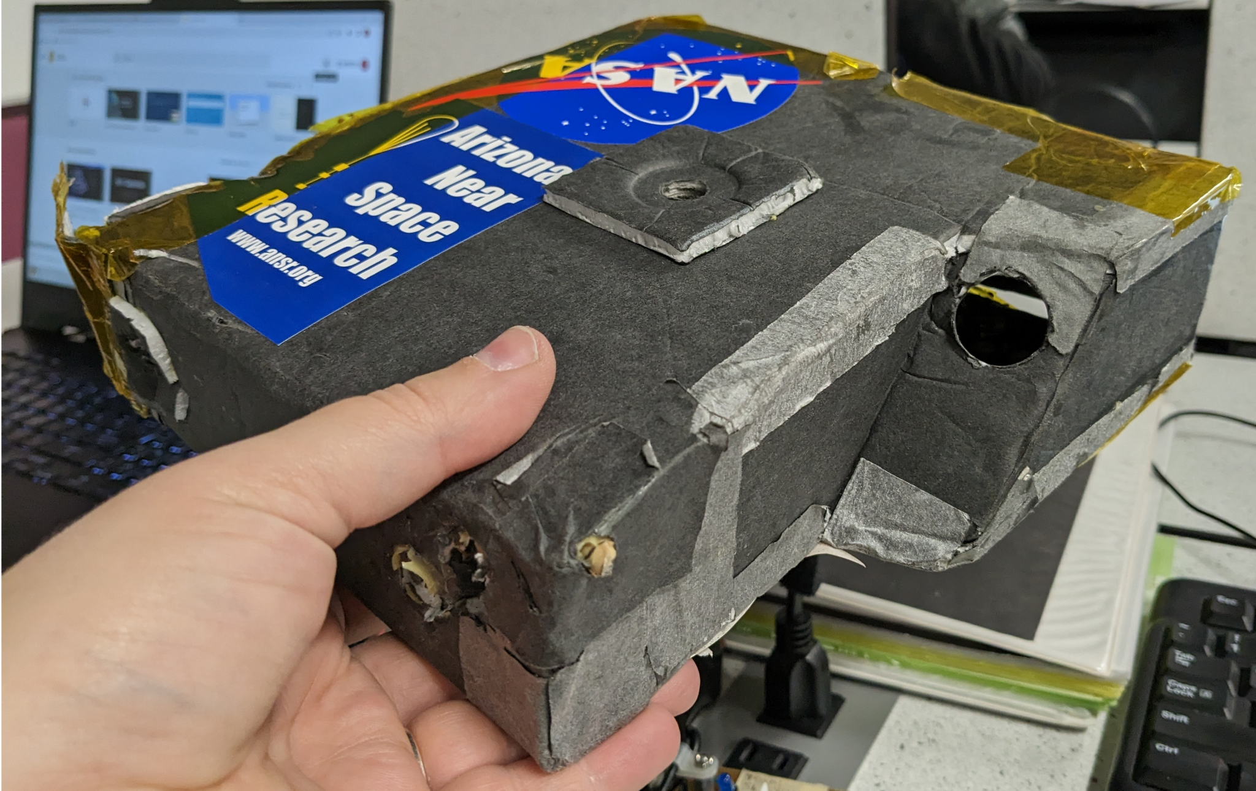
Payload Housing

Slide 6
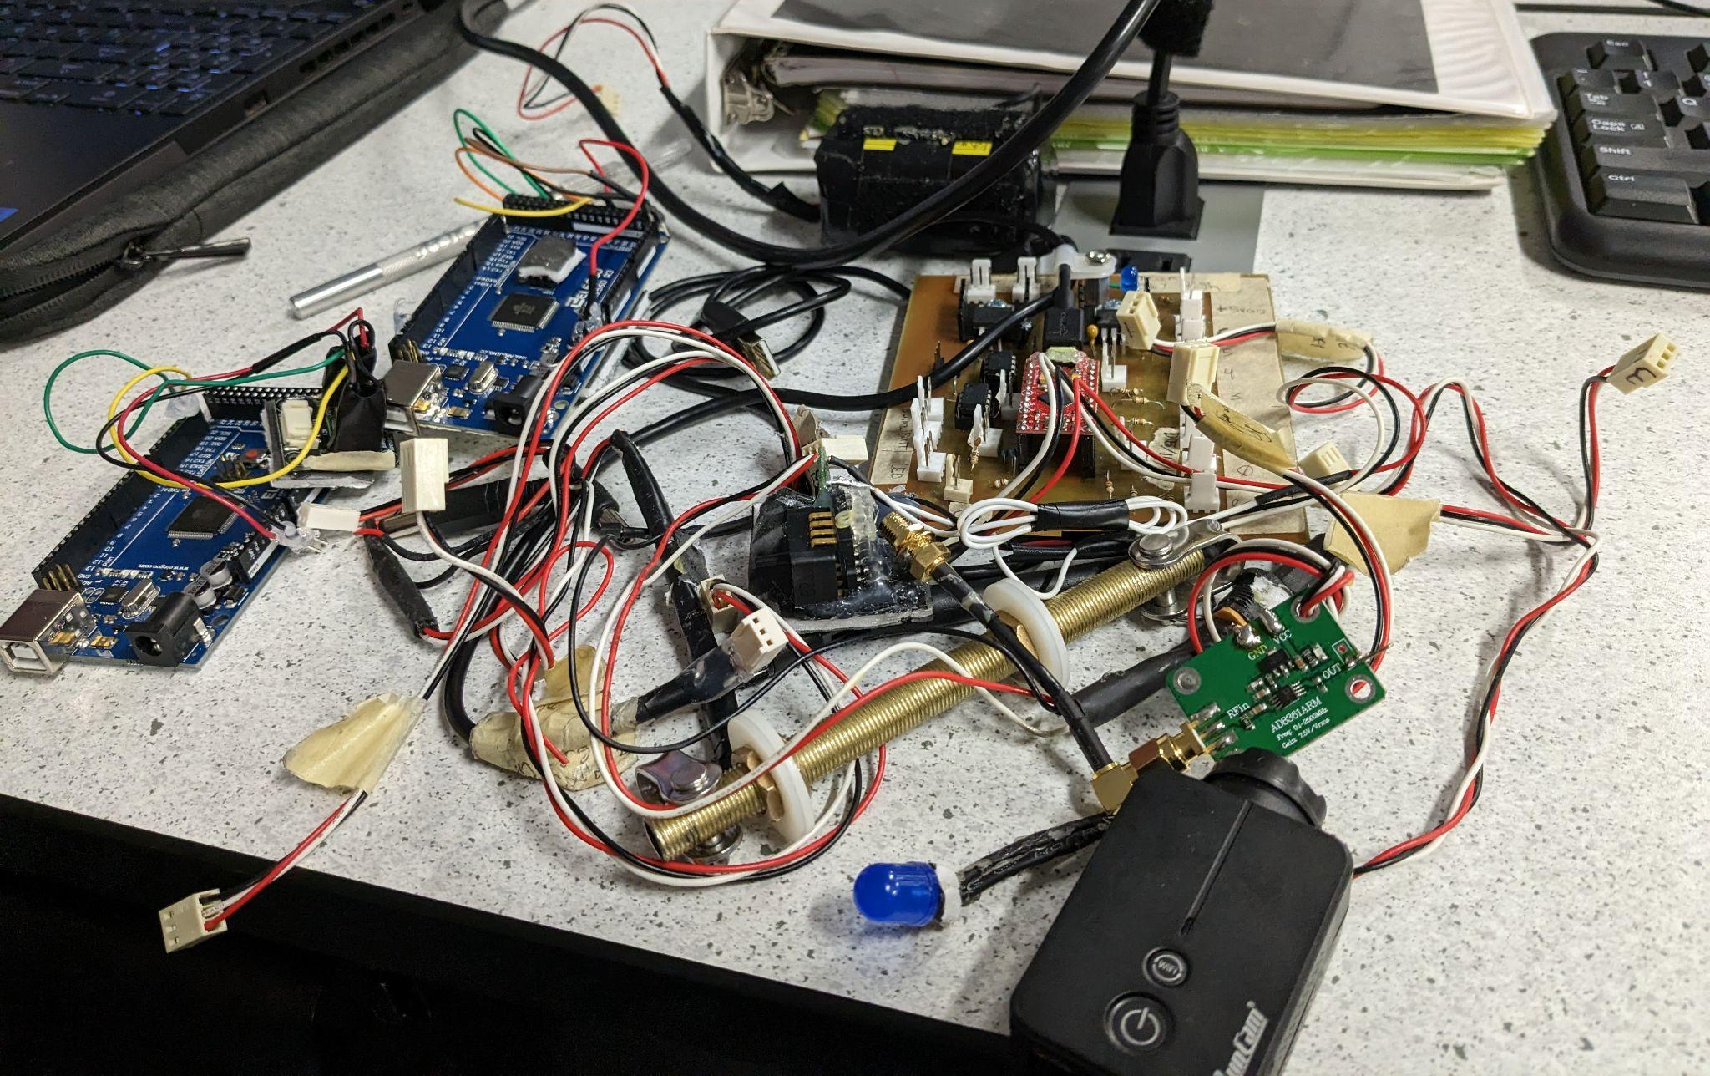
Stuffed Inside payload

Slide 7
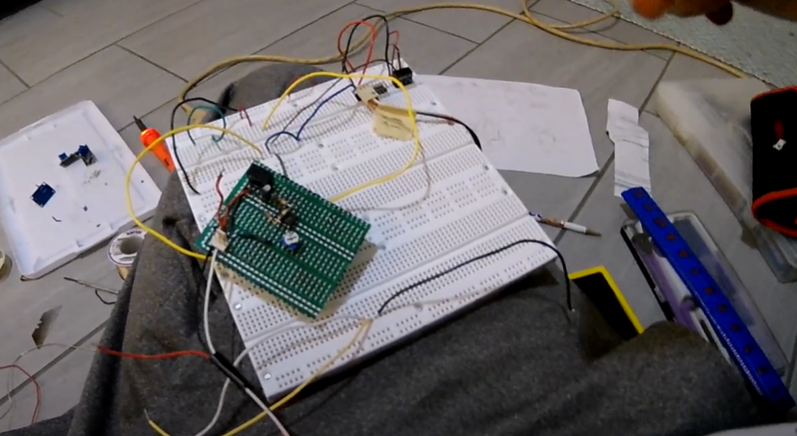
RF Field Sensor

Slide 8
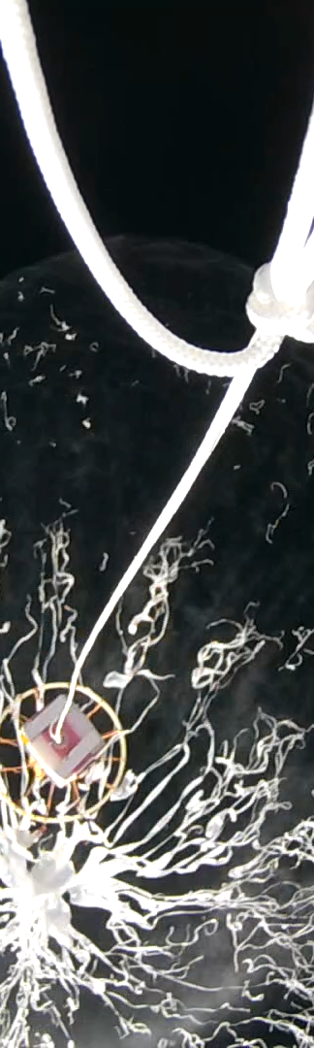
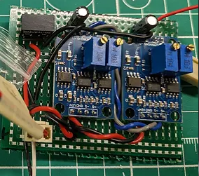
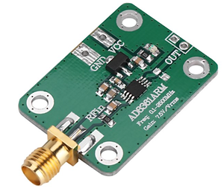
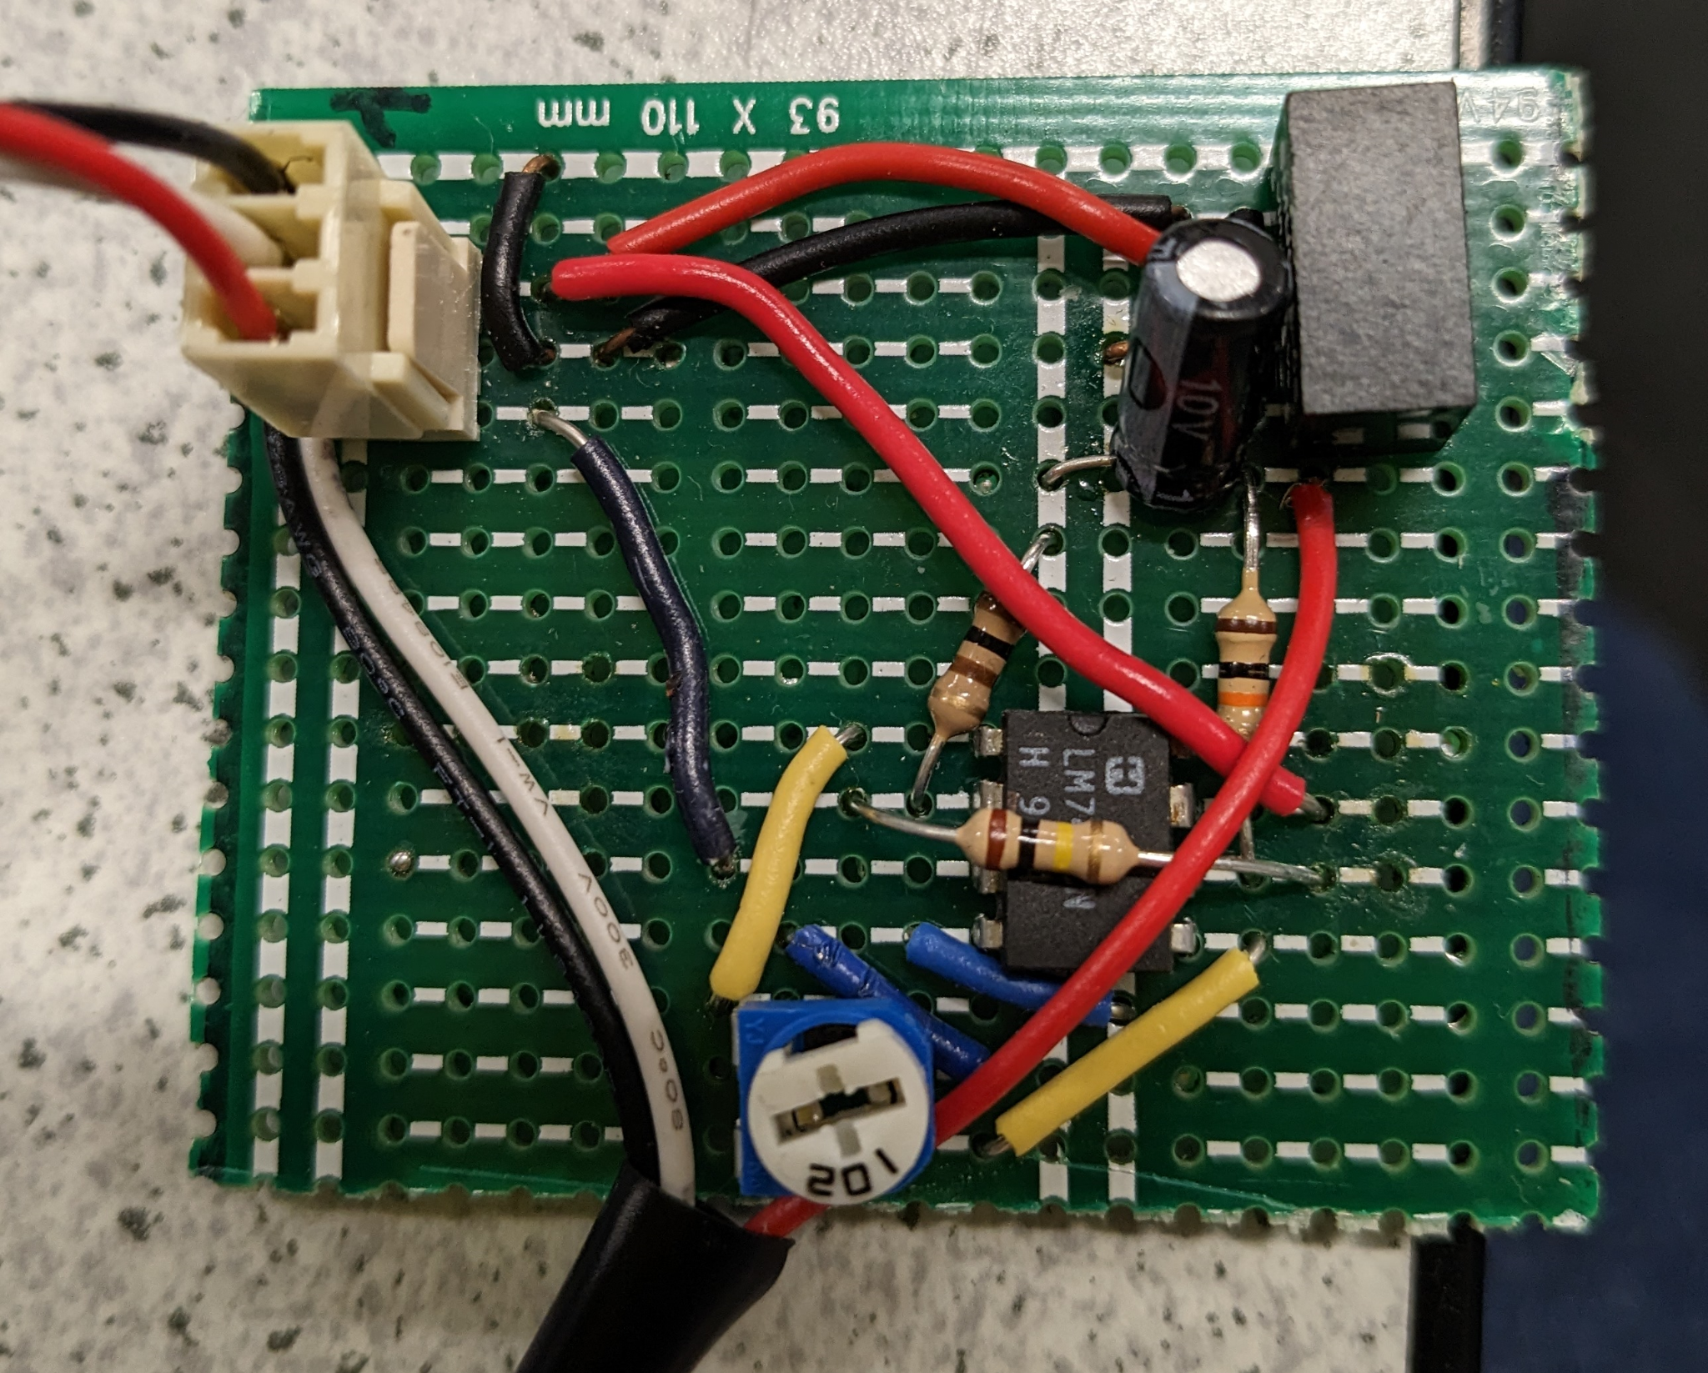
The story of the RF Field sensor:
The RF Field sensor
The new OP-Amp based amplifier
First amplifier shorted out during calibration

Slide 9
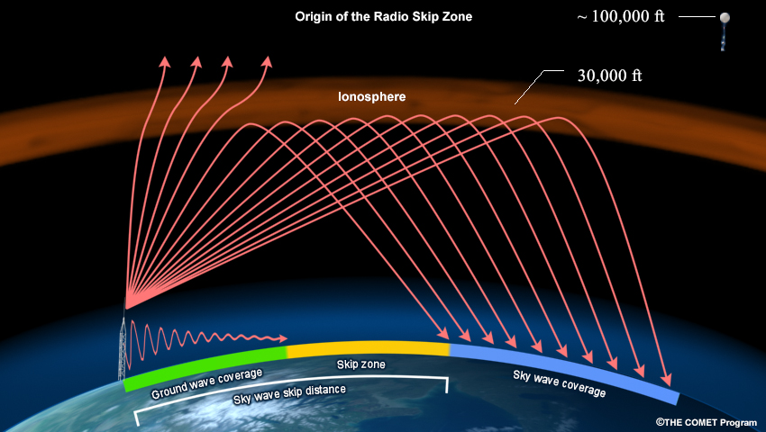
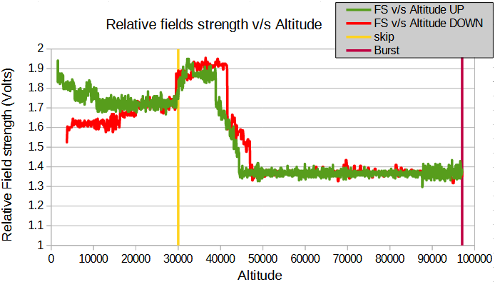
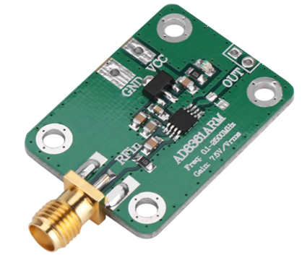
The Relative Field Receiver
Range: 0.1-2K MHz
Mission: Prove Skip exists!

Slide 10
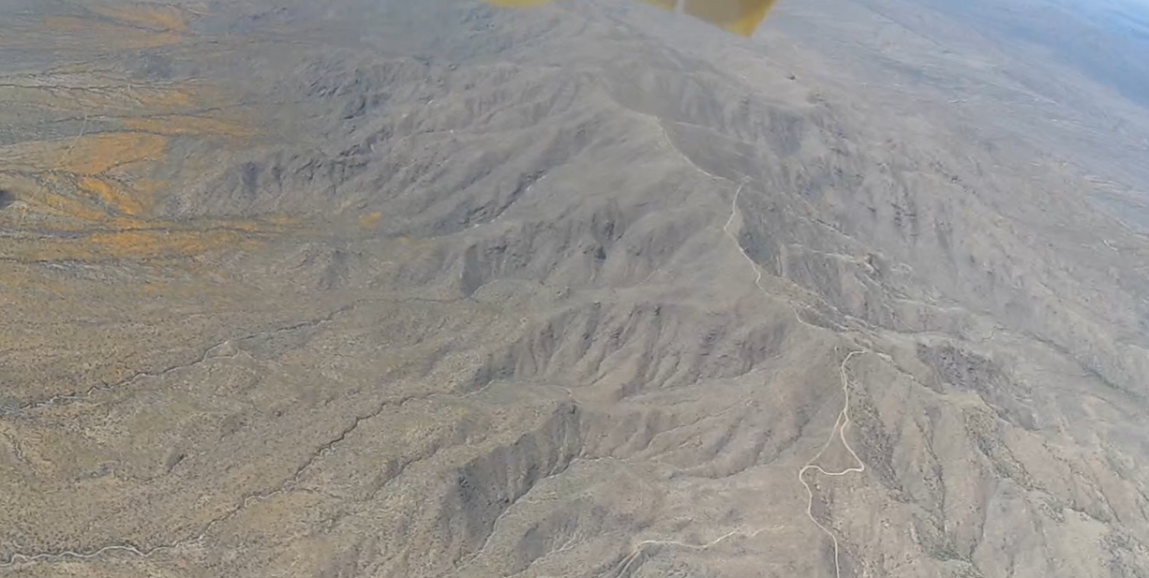
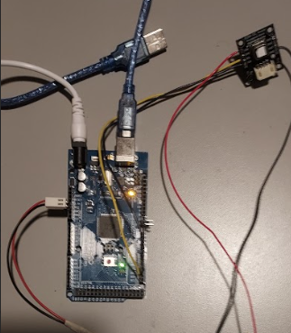
CO2 and Humidity Sensor
CO2 and humidity at higher altitudes

Slide 11
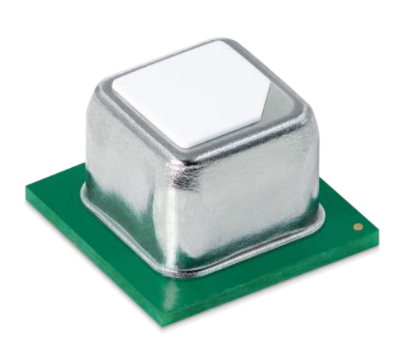
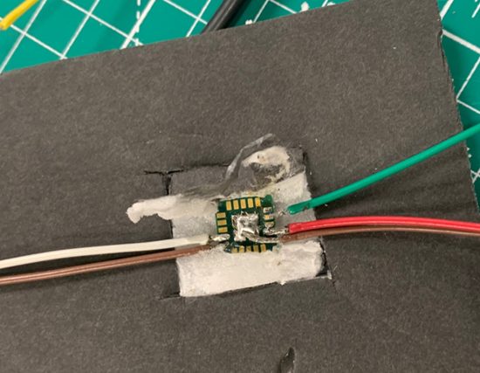
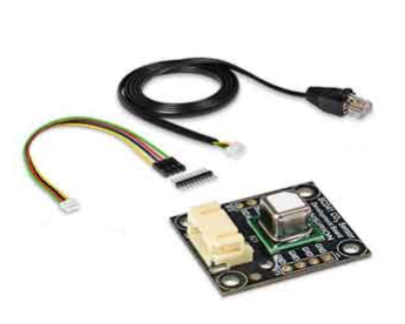
SCD41 CO2 Sensor
Hardware
Measures C02 ppm
Gives Humidity Readings
Communicating with Arduino

Slide 12
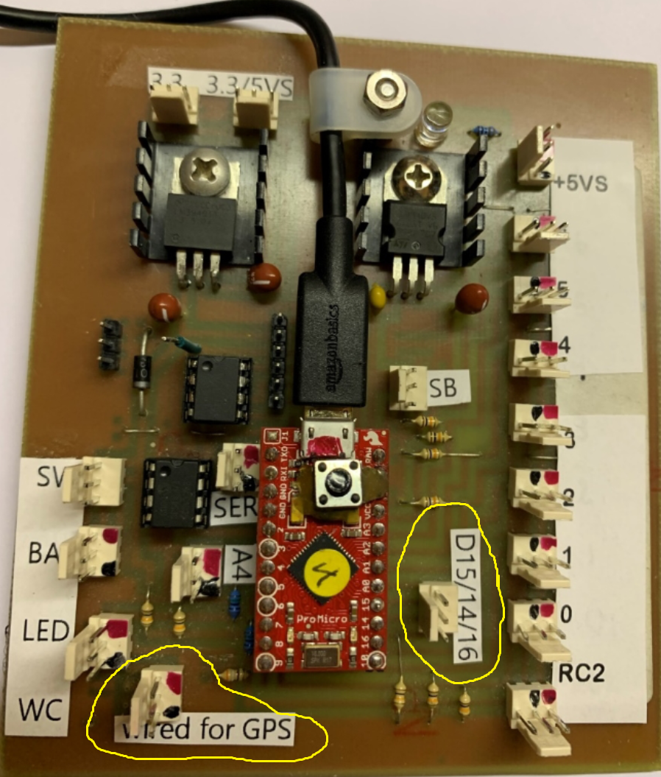
CO2 Sensor Issues
Notes:
Flight Data Recorder accepts analogue signals, but not digital.

Slide 13
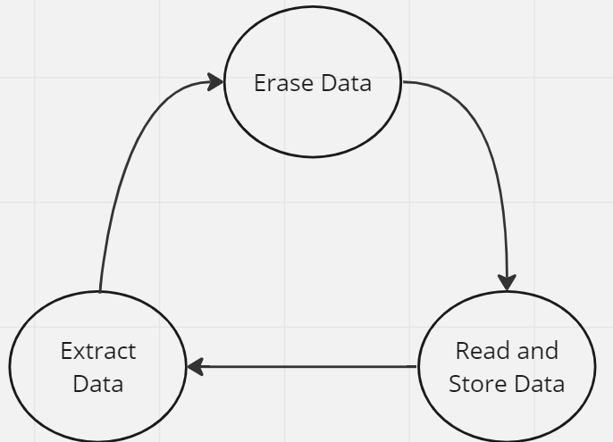
CODES FOR CO2 SENSOR

Slide 14
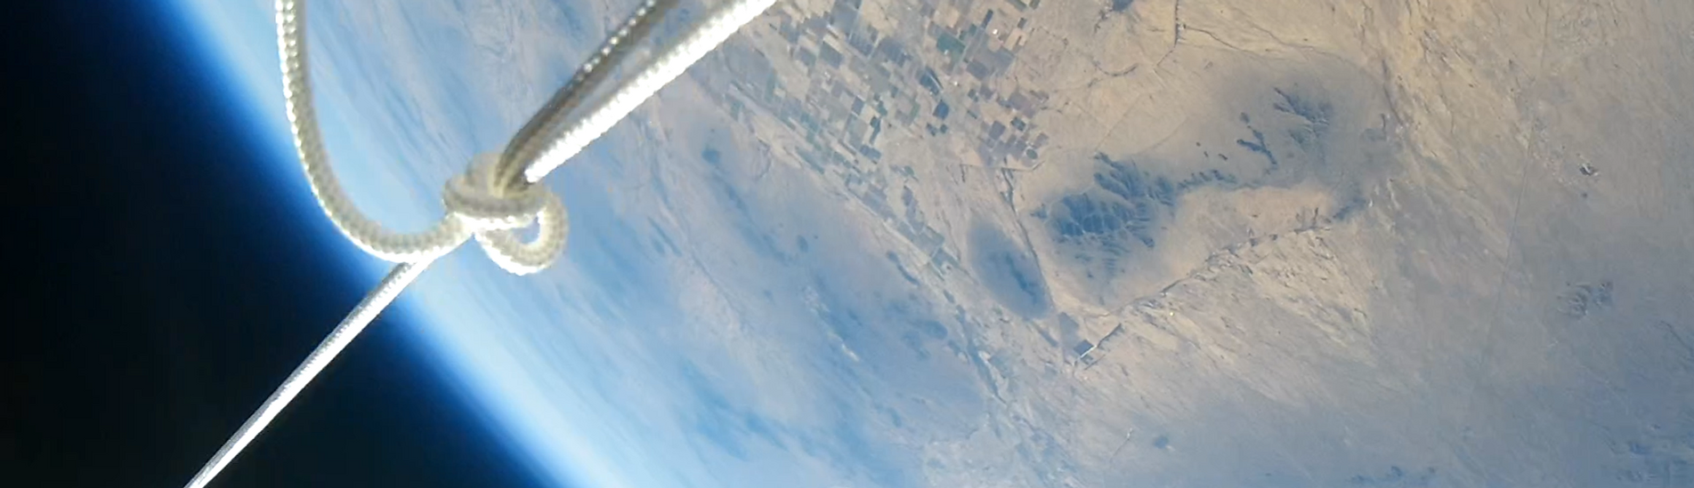
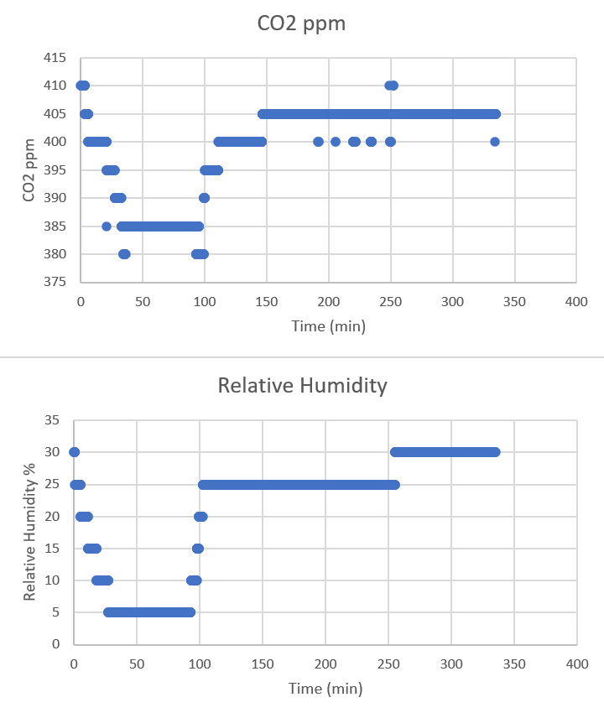
SCD41 CO2 Sensor Data
Notes:
CO2 Readings drop as we increase altitude.

Slide 15
Radiation vs Plant Seeds
The purpose of this experiment was to measure the radiation and determine the effect is had on seeds

Slide 16
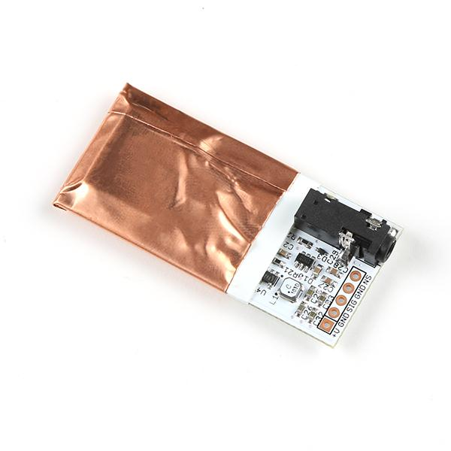
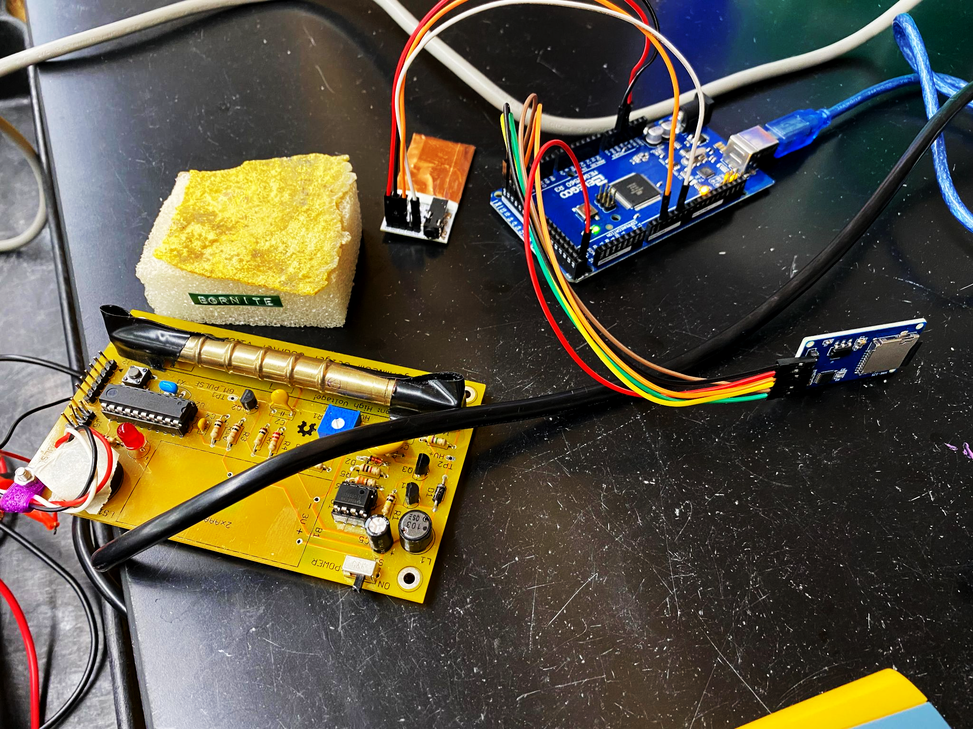
Geiger Counter
Pocket Geiger Counter from Radiation Watch
Detects Beta and Gamma Rays.
Used two different codes to run and store data to separate SD card
Calibrated and tested using a sample of radioactive material

Slide 17

Geiger Mishap
No data Geiger counter was recorded during the flight.
The wire powering the Geiger counter disconnected from the Arduino.
Wire pin was too small for socket.

Slide 18
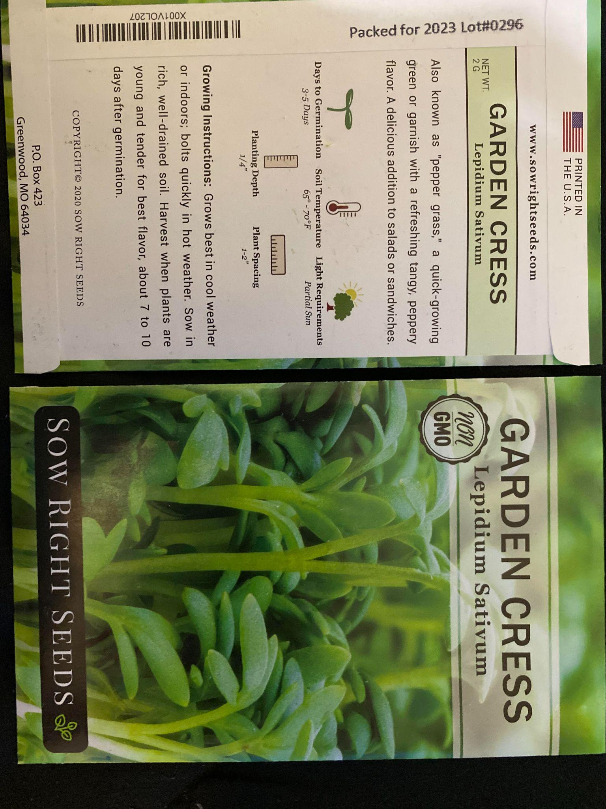
Plant Seed Experiment
Garden Cress Seeds
Before launch, a batch of seeds were grown to show viability.

Slide 19
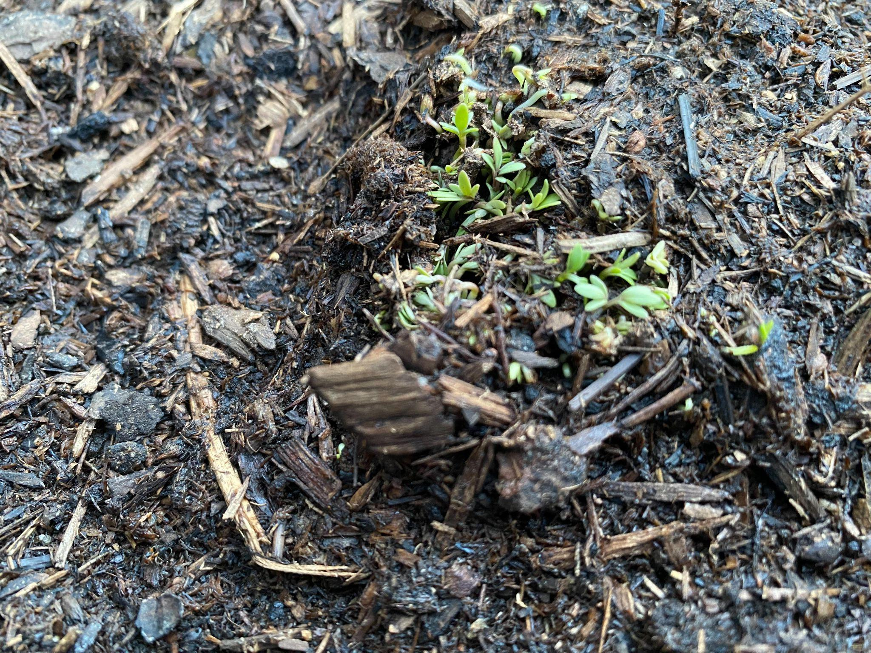
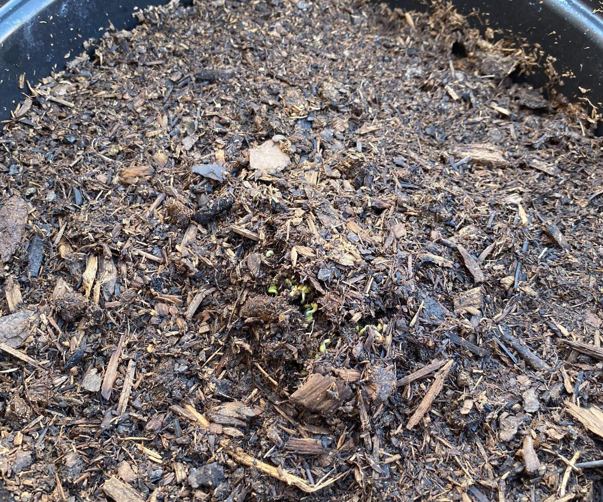
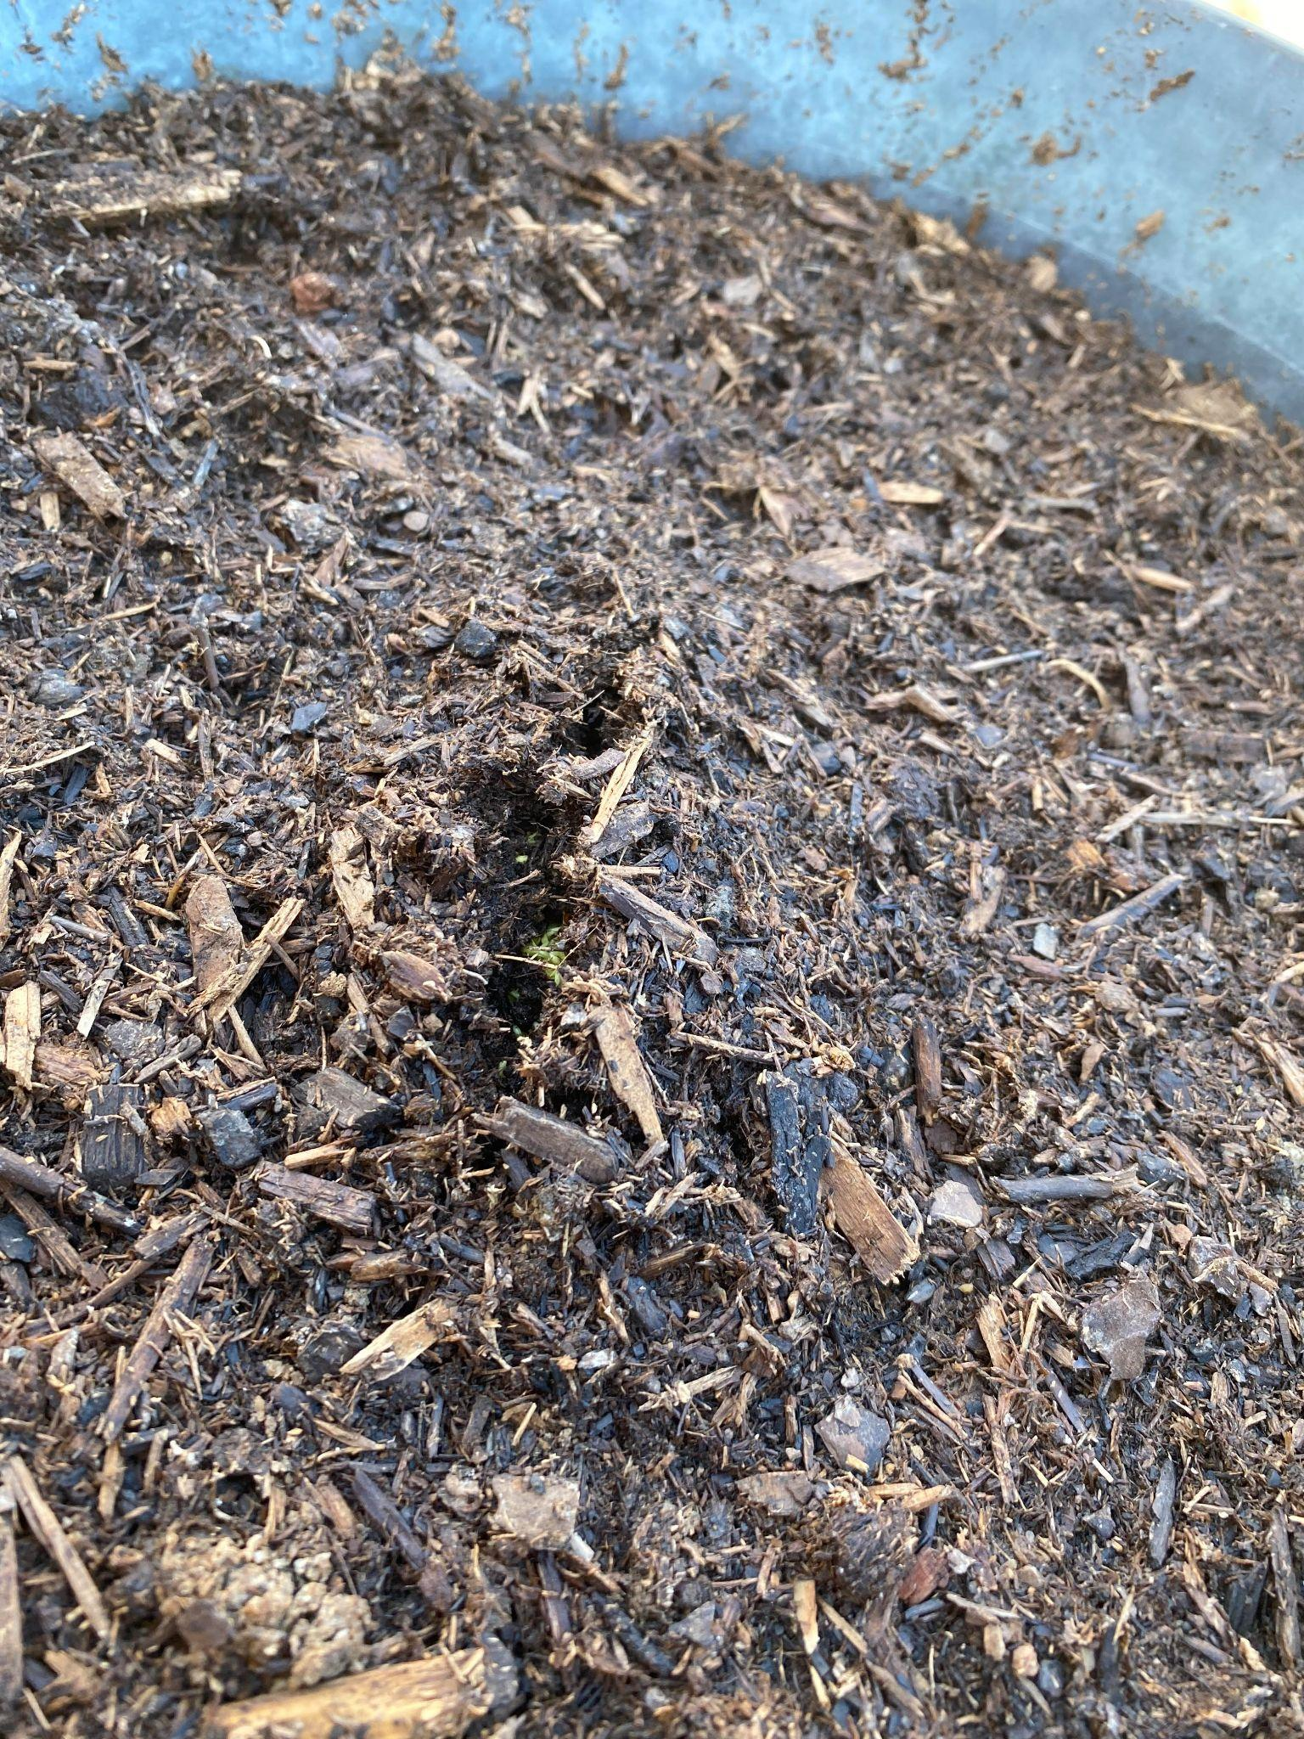
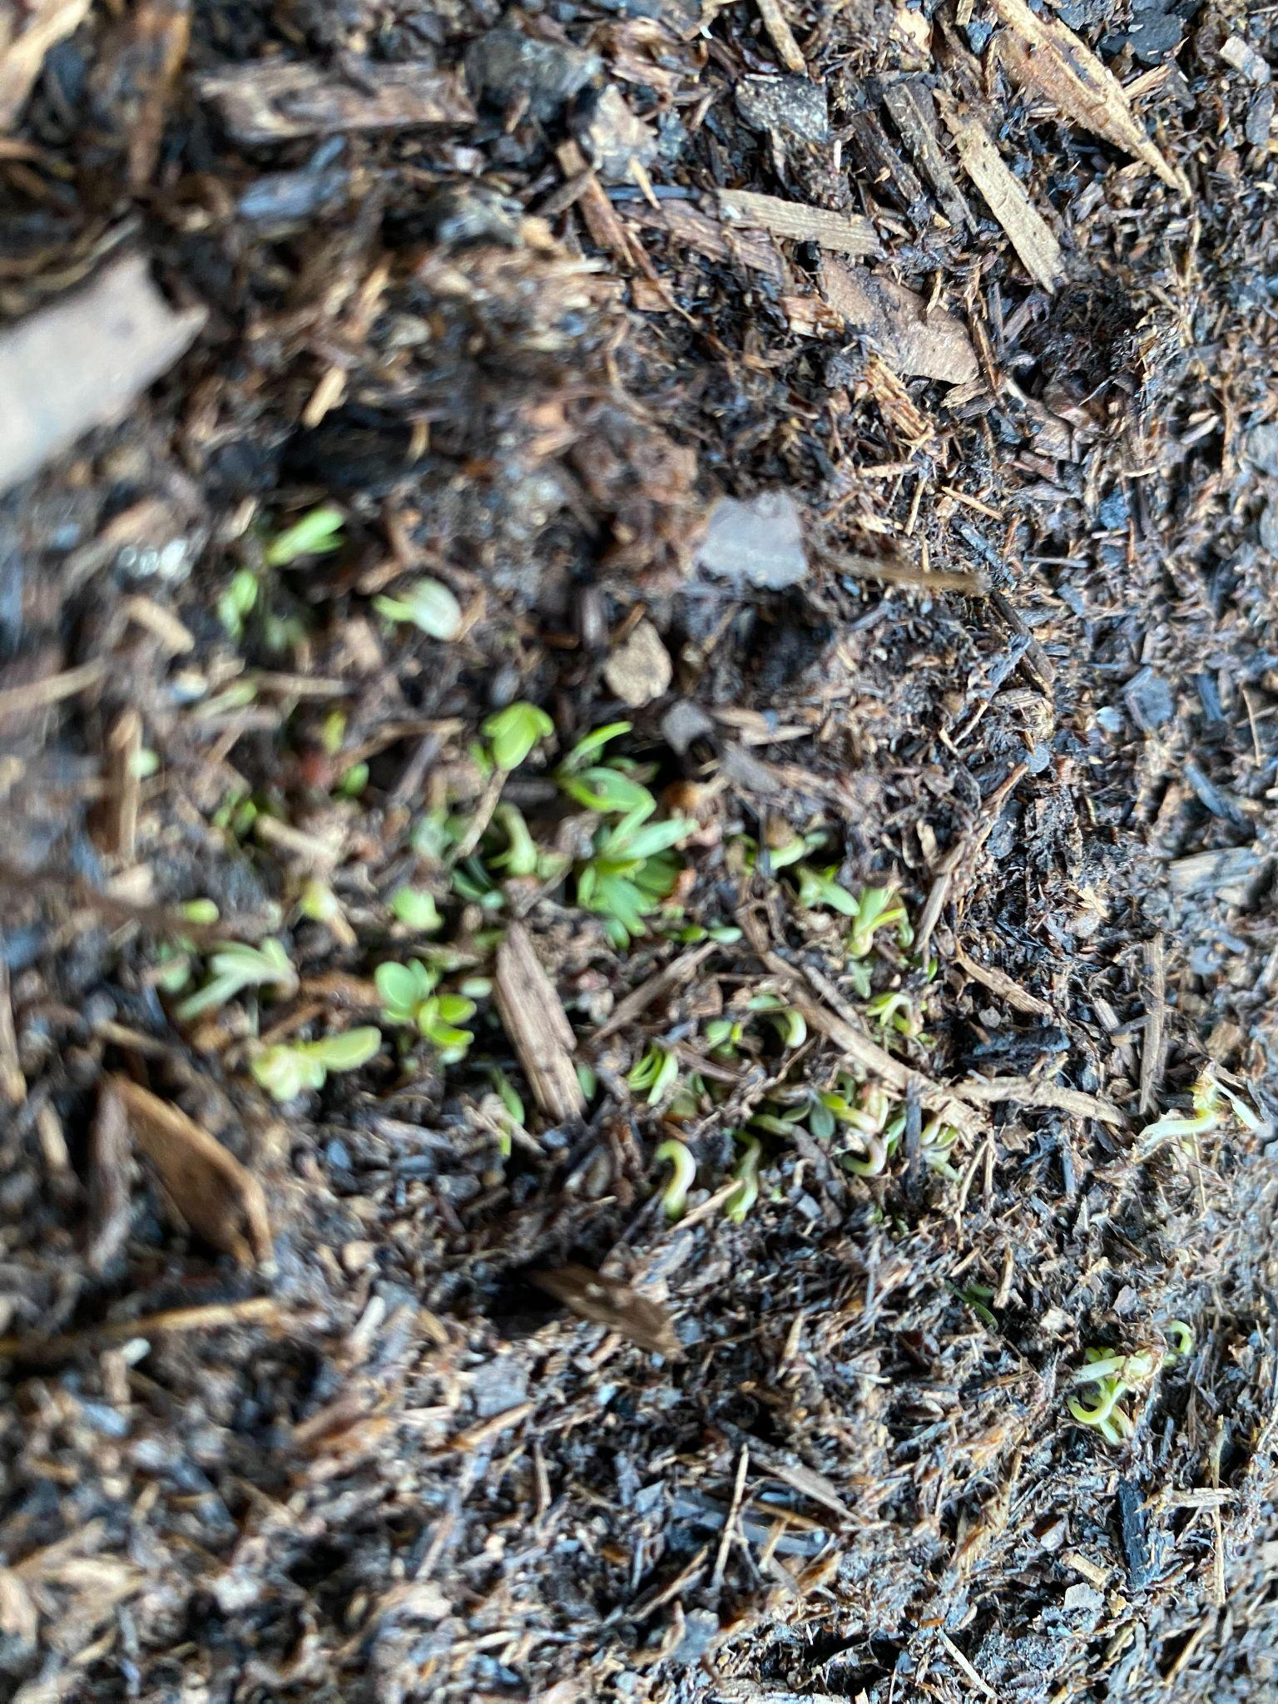
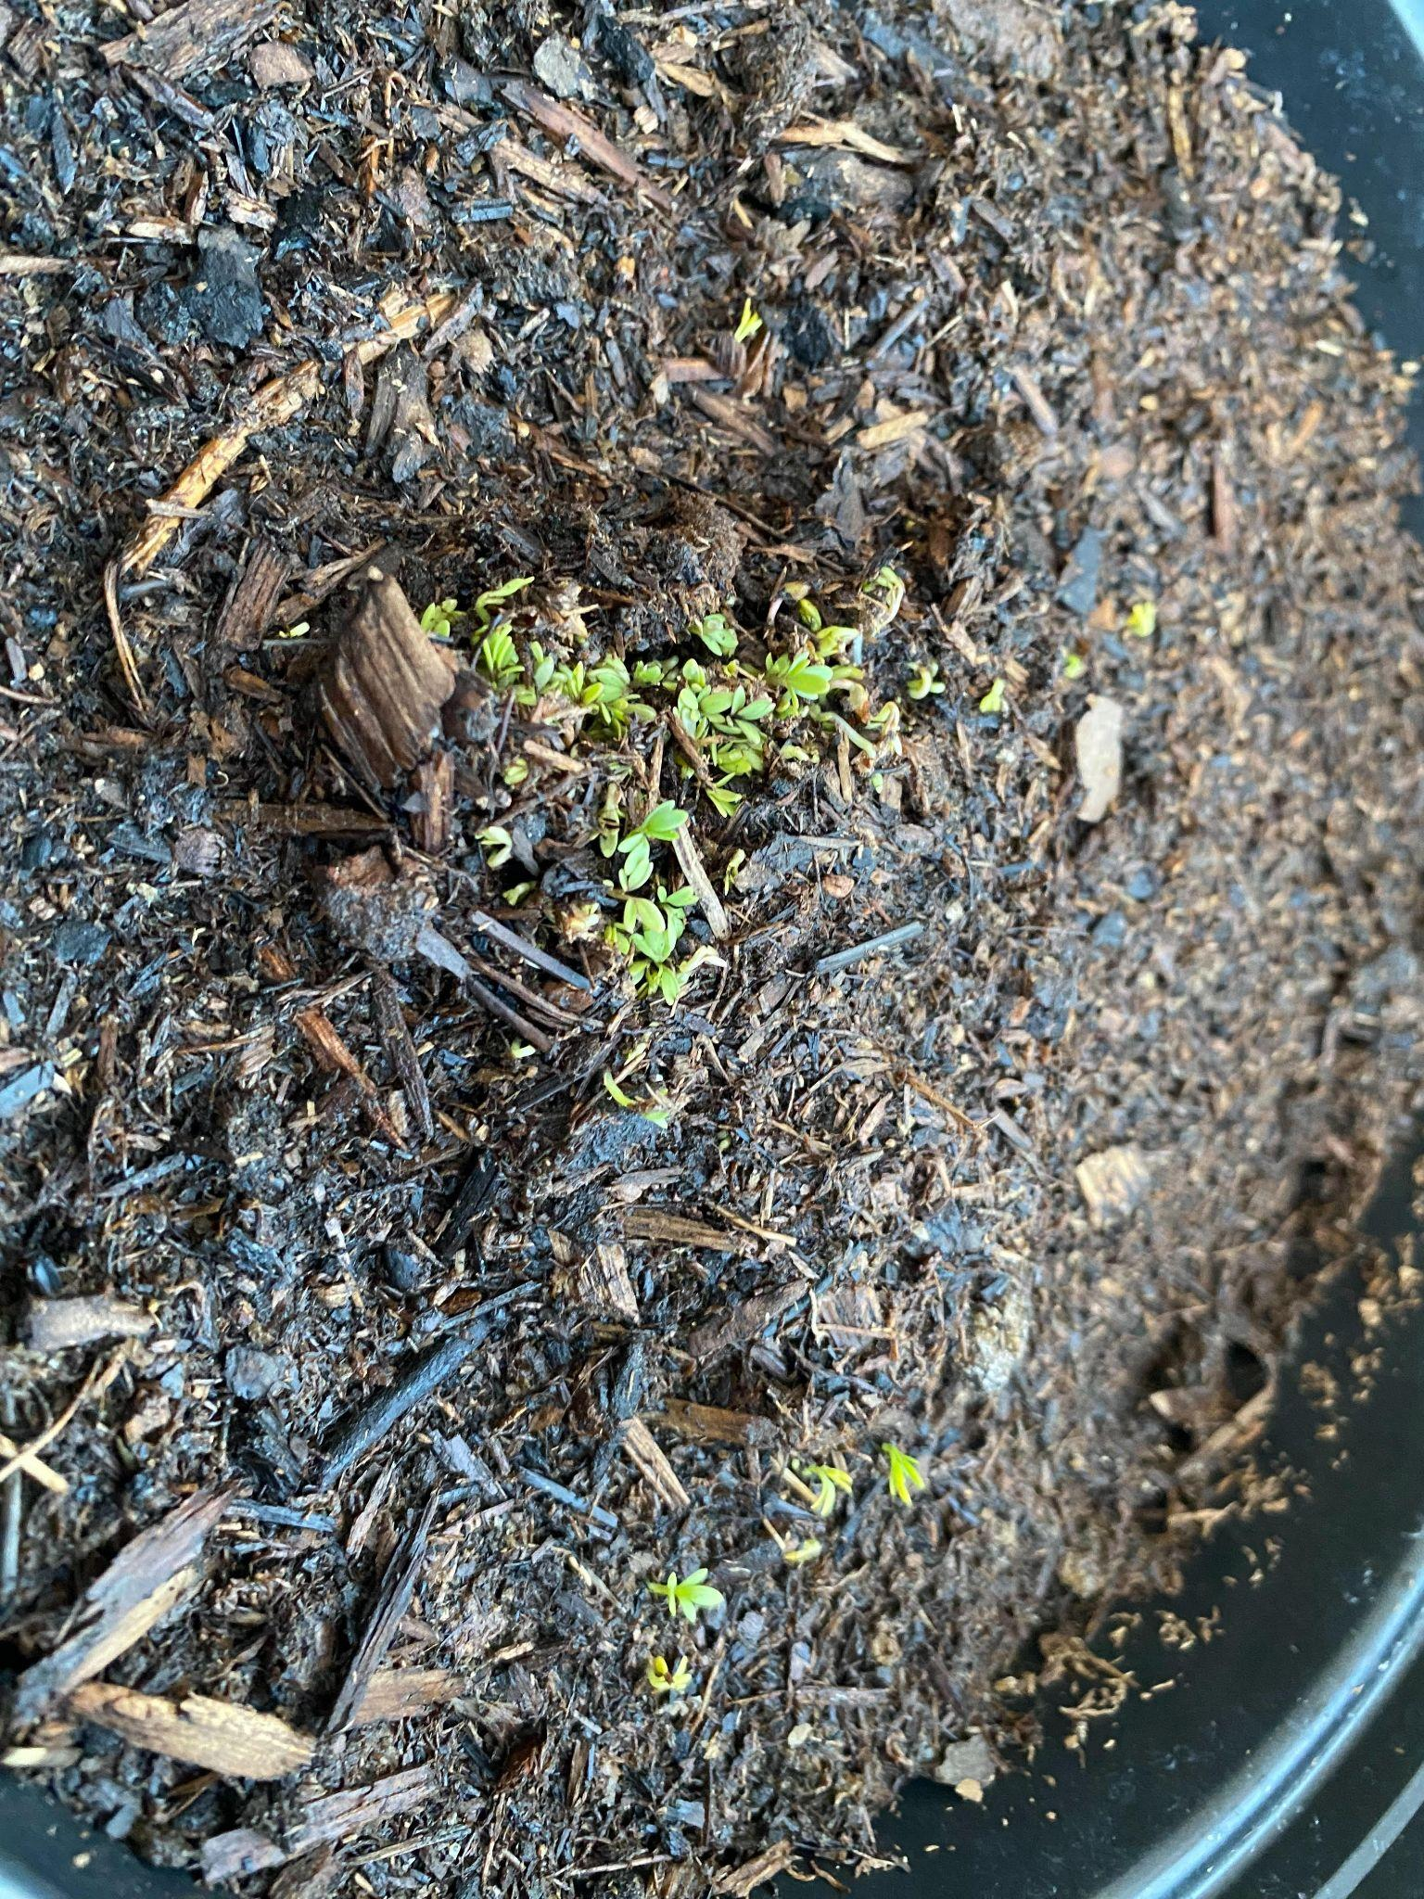
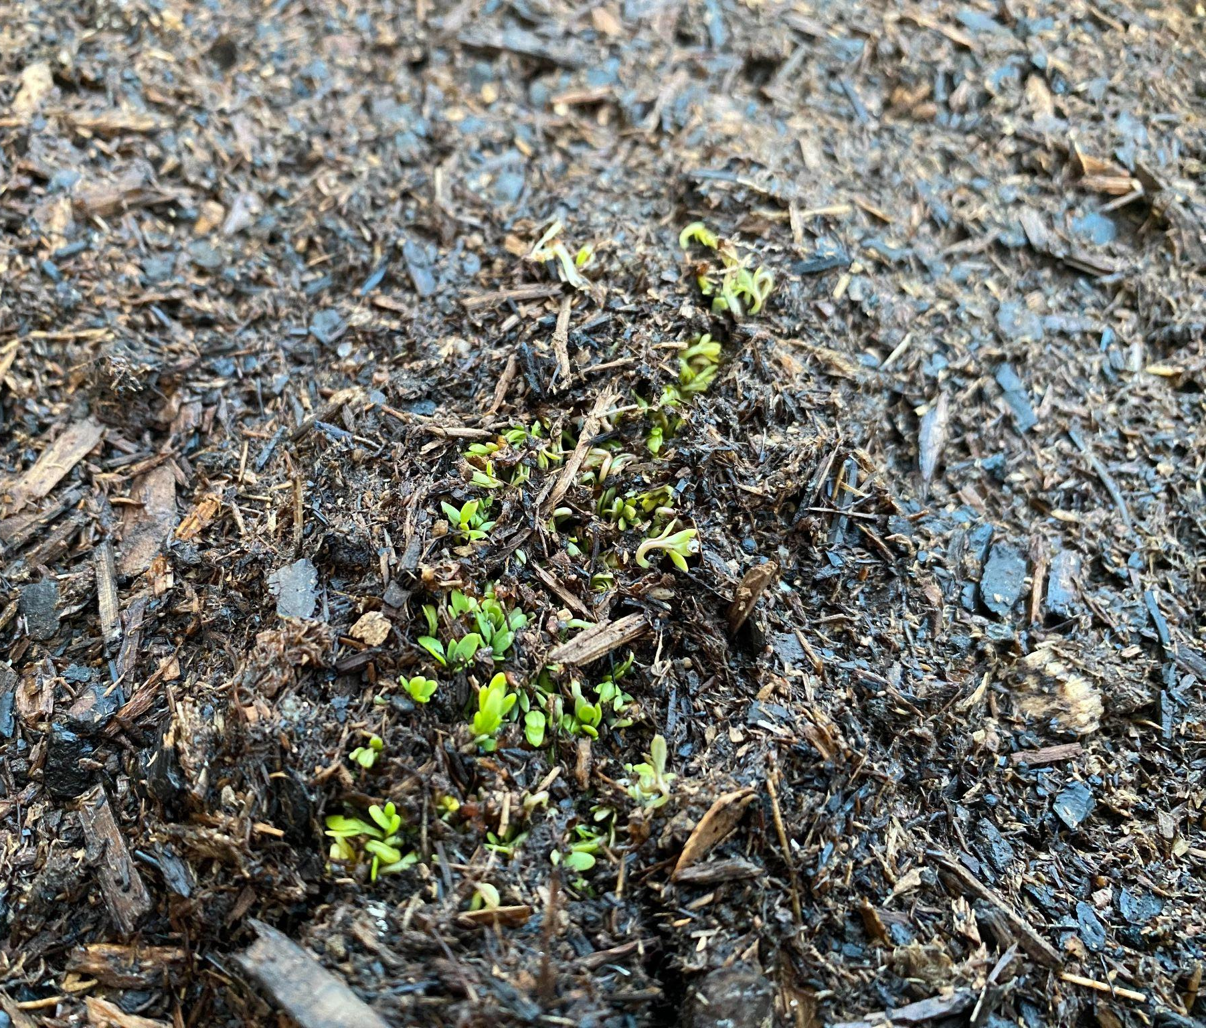
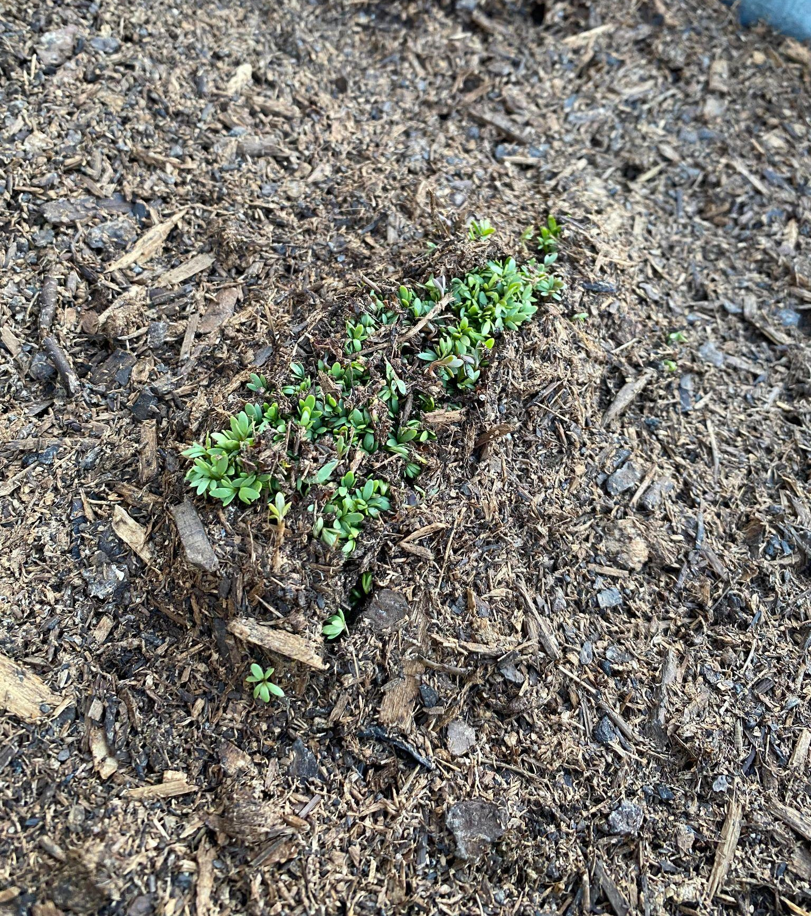
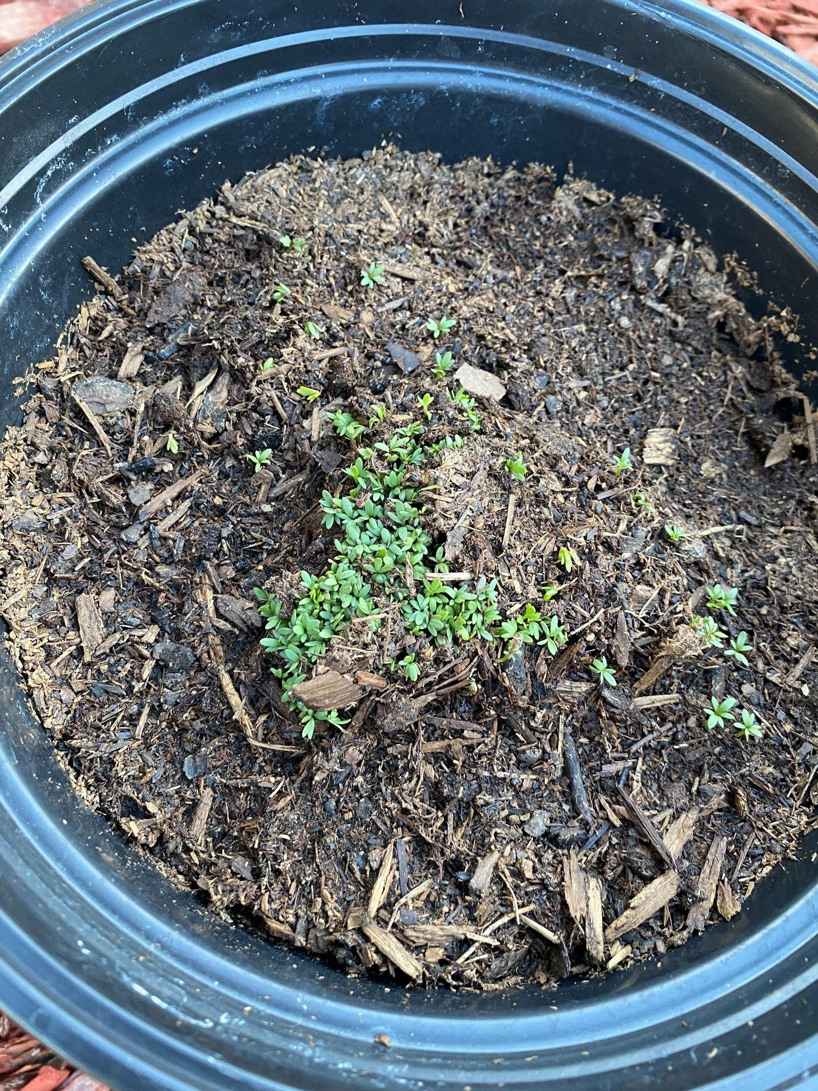
Flight Group
Non-Flight
Day 5 morning
Day 5 evening
Day 5 morning
Day 5 evening
Day 6 Evening
Day 6 morning
Day 6 evening
Day 6 Morning

Slide 20
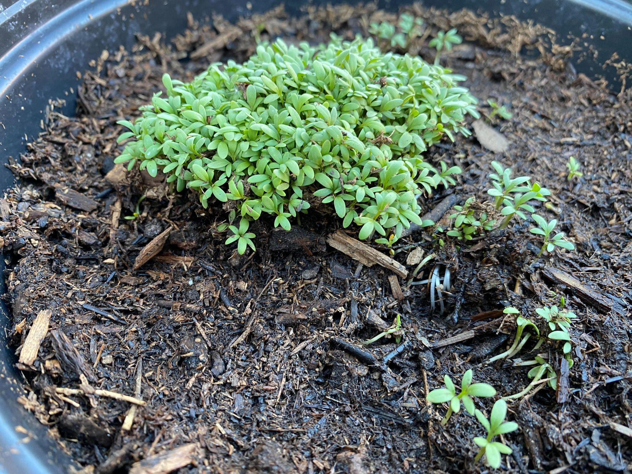
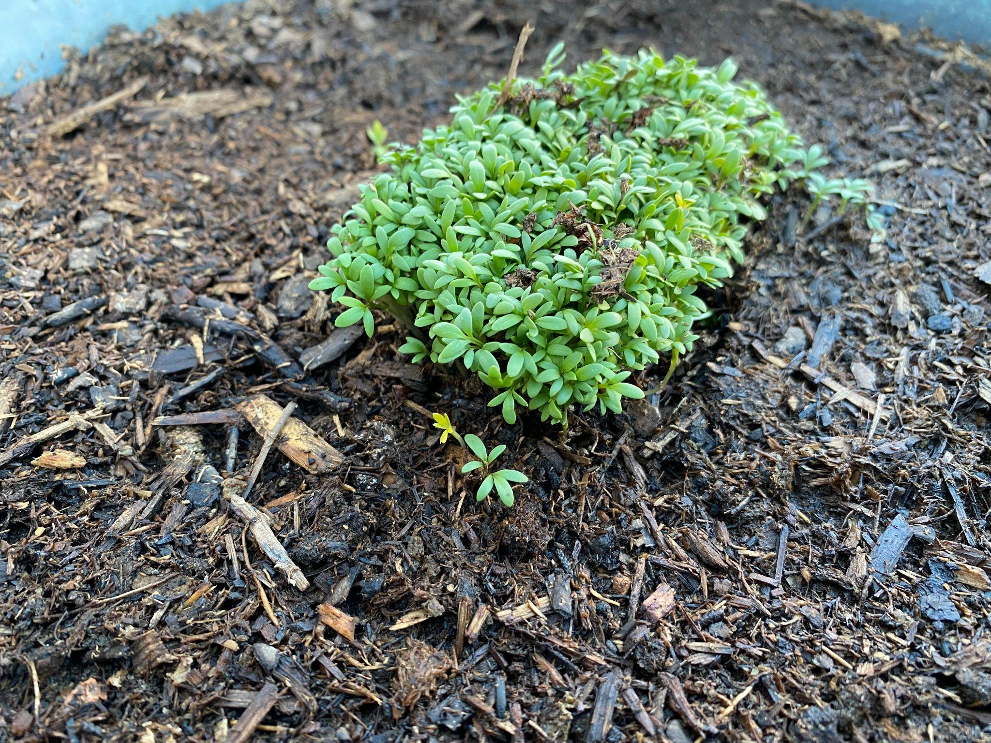
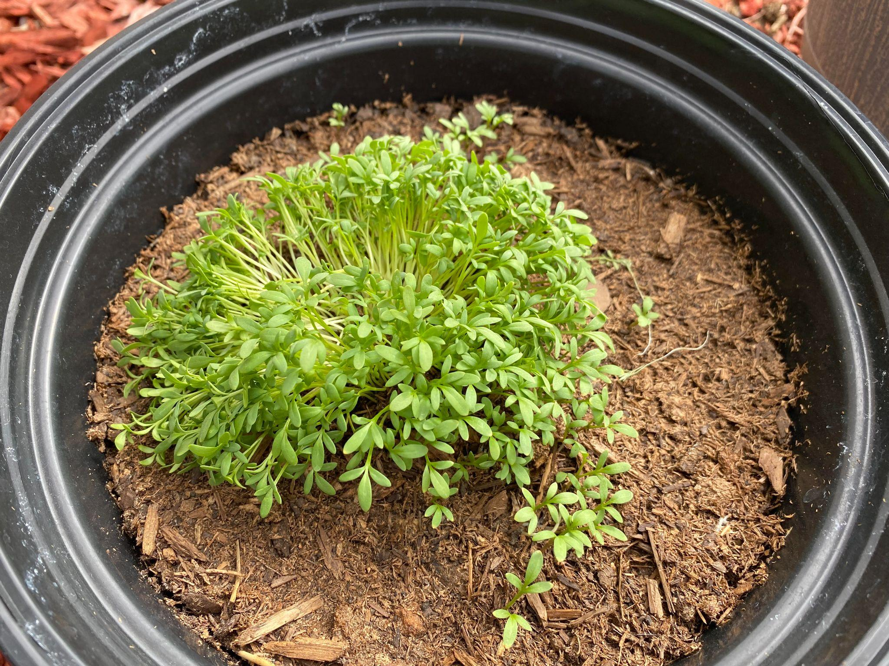
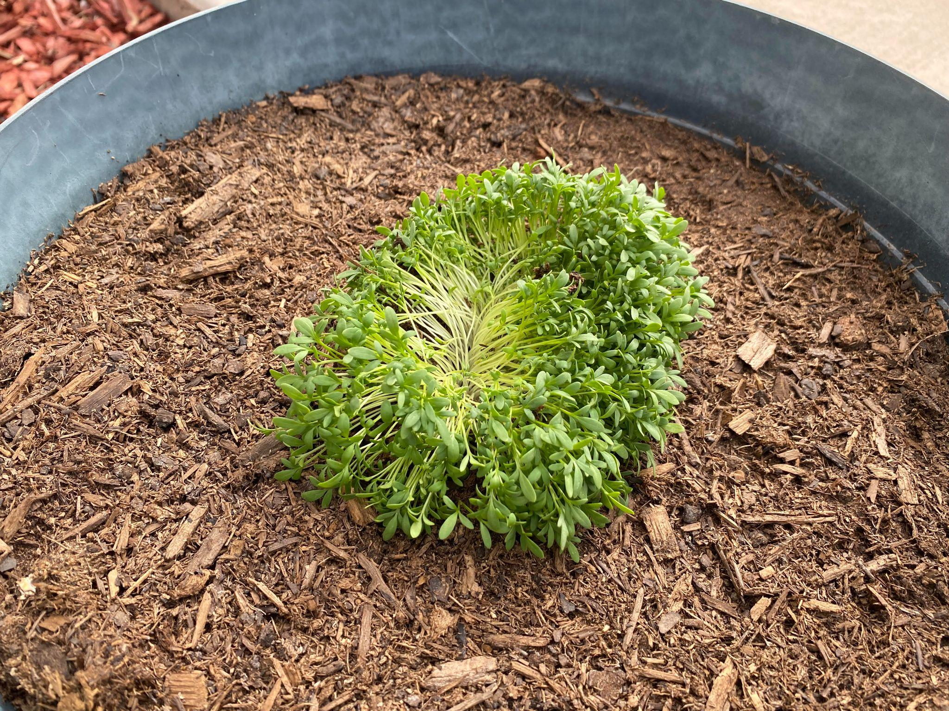
Flight Group
Non-Flight
Day 8 Morning
Day 8 Morning
Day 11 Evening
Day 11 Evening

Slide 21
Overall Growth
Flight vs. Non-flight
Flight (mm) | Non-Flight (mm)
78 | 90
88 | 55
34 | 21
83 | 90
Seeds after flight were still able to grow.
10 Samples were taken from each batch.
Measurements taken with a caliper and measured in mm.
Measurements taken on day 11.
51 | 53
41 | 79
63 | 44
36 | 87
44 | 44
68 | 45
Average (mm) | 58.6 | 60.8
Notes:
Flight conditions did not harm them

Slide 22
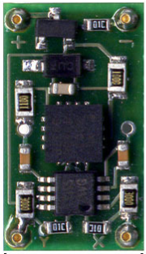
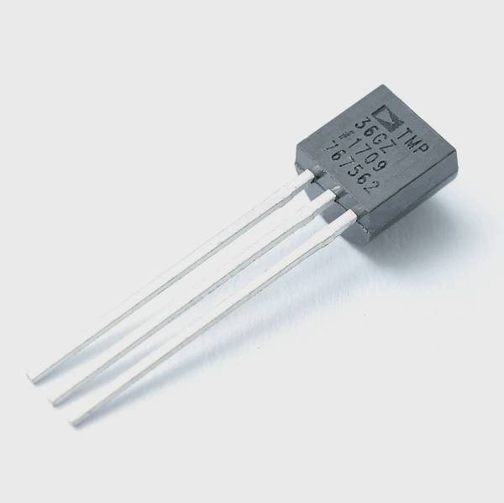
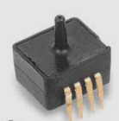
ACCELEROMETER
TEMPERATURE
PRESSURE
ADDITIONAL SENSORS
DE-ACCM6G Buffered ±6 Accelerometer
3 TMP36 Temperature Sensors
Camera Sensor
Seed Sensor
External Sensor
ASDX Series Pressure sensor (ASDX015)

Slide 23
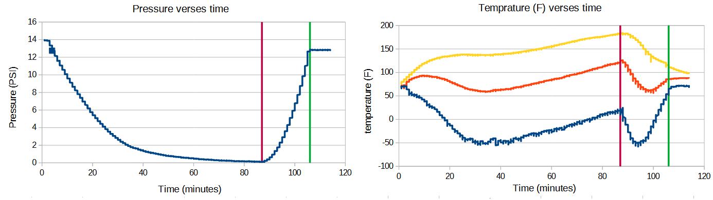
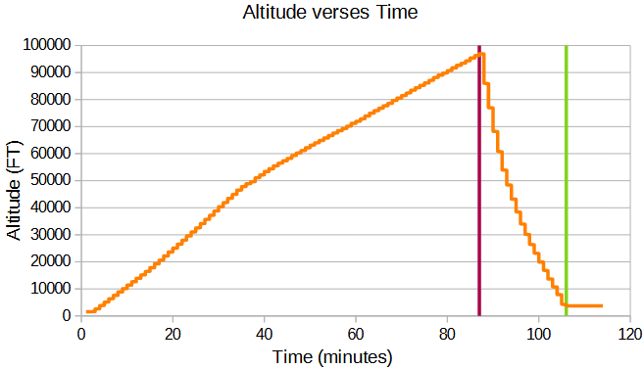
Burst Land
Camera
Seeds
Outside

Slide 24
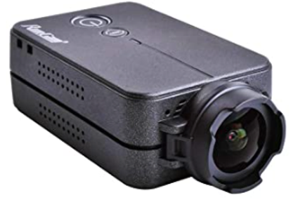
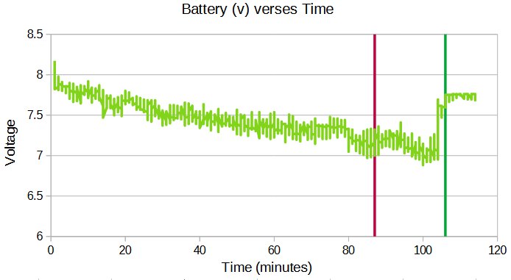
Camera
Runcam 2
Records 1080p 60 FPS
Recorded launch, through burst, then stopped
Memory card was full
We forgot to erase 24 hours of test footage

Slide 25
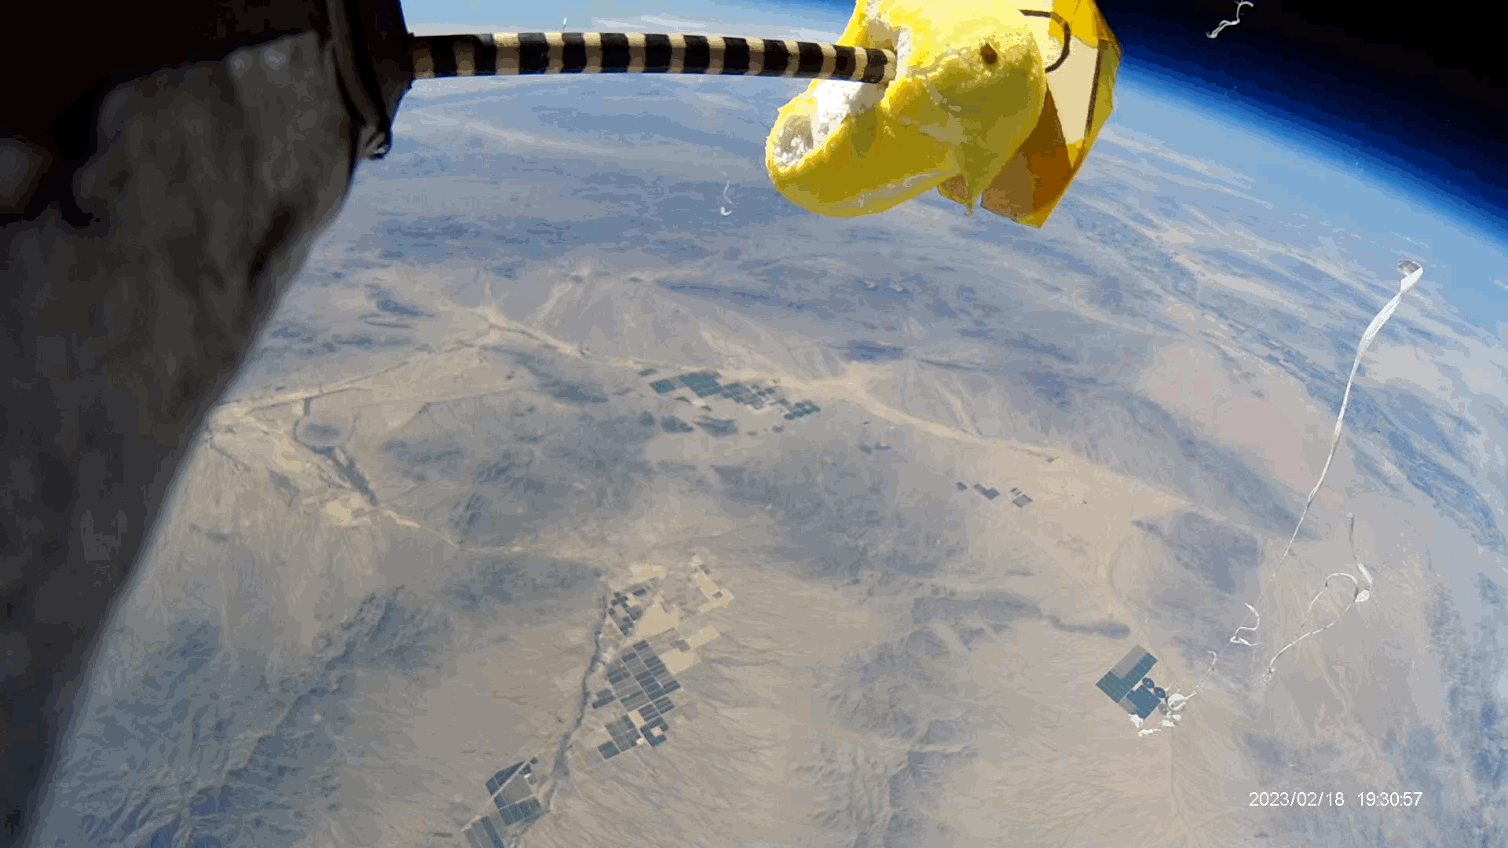
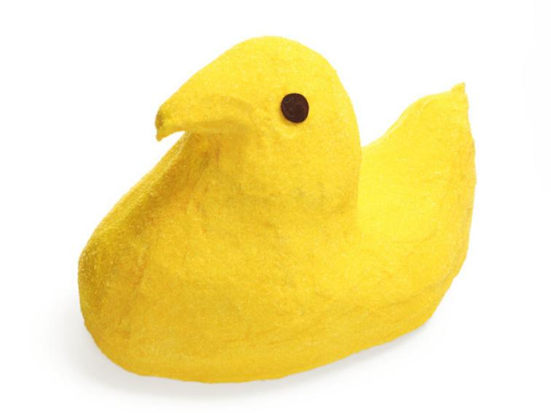

Slide 26





QUESTIONS?
Jose ocampo
Rik Bloemers
Shelby Bump
GenARO Rivera

Slide 27


Visit our website!
< SCAN ME!
https://rik2049707.wixsite.com/ascend

